Slide 1


Safety Monitoring in Hazardous Goods Warehouse
Team Members:
1. Malaravan S
2. Mitun T S
3. Mohithaa K
4. Monish Kiran A
5. Mukhil R
6. Murikinati Dheeraj Kumar Reddy
7. Nandan Rajesh

Slide 2

Content
Project Overview
Problem Statement
Project Goal & Observations
Proposed Solution
Resources Utilized
System Design
Implemented Details
Results and Observations

Slide 3
Project Overview
Brief Introduction: This project develops a smart safety system for hazardous goods warehouses by integrating:
Raspberry Pi Pico – as the central microcontroller for sensor interfacing and control
IR-based Flame Sensor – for rapid fire detection
BME680 Sensor – for monitoring temperature, humidity, and gas concentration
OLED Display – to visually present real-time sensor readings for on-site monitoring
The system continuously monitors environmental conditions and triggers alerts when unsafe situations are detected.
Purpose of Combining Embedded Systems with Machine Learning (ML)
- Embedded Systems handle real-time sensor data collection.
- ML analyzes historical data to detect anomalies early.
- Enables predictive safety by identifying risks before accidents occur.
- Supports proactive decision-making and reduces accident risks.

Slide 4
Problem Statement
Problem Description:
Hazardous materials require constant monitoring for fire, gas leaks, and environmental conditions. Fire, BME680, and DHT11 sensors collect temperature, gas, and humidity data, which is transmitted to the cloud. ML models detect early signs of danger. Data analytics supports historical trend analysis, event correlation, and predictive alerts. Visualization tools display environmental patterns, helping to trigger automated safety protocols and reduce accident risks.
Why It Matters:
Protects Human Safety: Early alerts prevent injury or loss of life in high-risk environments.
Safeguards Assets: Avoids costly damage and supply chain disruptions.
Regulatory Compliance: Ensures adherence to safety standards (OSHA, NFPA).
Predictive Intelligence: ML models detect risks before they become critical.
Environmental Responsibility: Prevents harmful gas leaks and spills.
Automation & Efficiency: IoT systems enable faster, automated safety responses.

Slide 5
Project Goal & Objectives
Main Project Goal: Design an intelligent safety monitoring system for hazardous warehouses using sensors, cloud-based communication, and ML for real-time detection and automated safety responses.
Objective 1: Real-Time Monitoring
Transmit temperature, gas, and humidity data to the cloud via ThingSpeak.
Objective 2: Hazard Detection Accuracy
Deploy ML models to detect fire/gas threats with ≥ 90% accuracy.
Objective 3: Alert Response Time
Trigger alerts within 3 seconds of abnormal environmental conditions.
Objective 4: Visualization & Compliance
Generate weekly safety reports and maintain 100% uptime on the cloud dashboard.

Slide 6
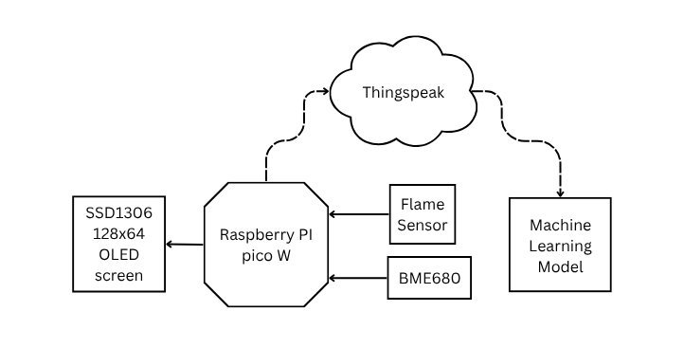
Proposed Solution
Architectural Design

Slide 7
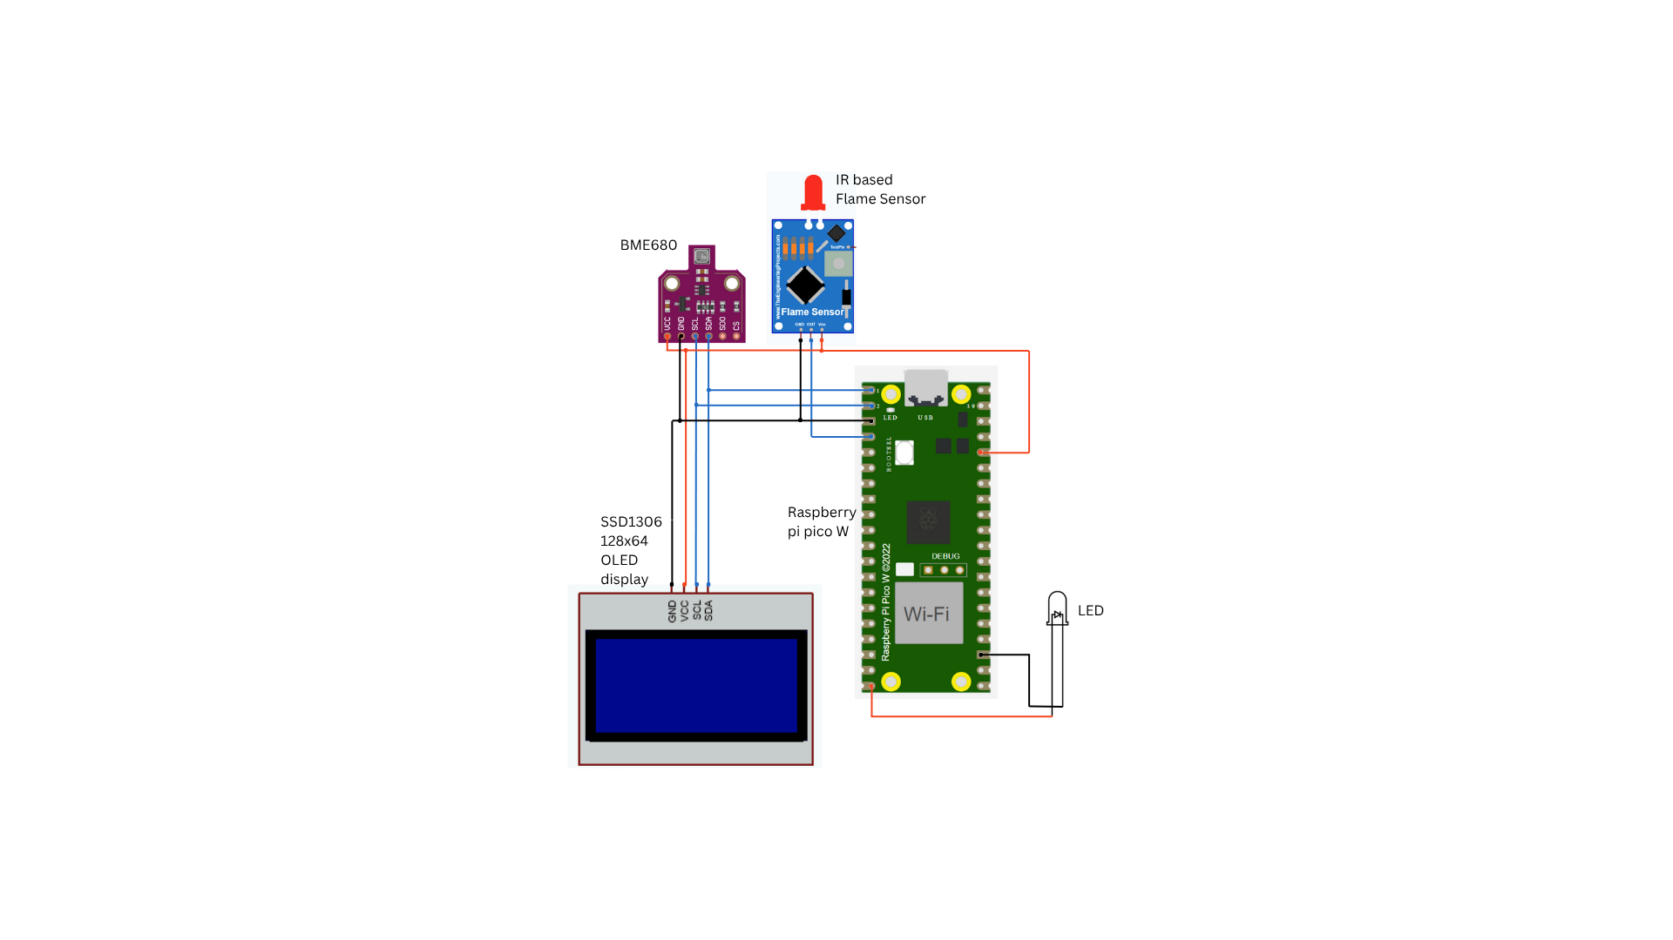
Circuit Diagram

Slide 8
Proposed Solution
How Embedded System + ML is integrated
1. Sensor Data Acquisition (Embedded System):
The Raspberry Pi Pico W collects real-time environmental data from the BME680 sensor (temperature, humidity, gas) and flame sensor.
Data is displayed on an OLED screen and indicated via LED/buzzer alerts if thresholds are crossed.
2. Data Transmission:
Collected data is transmitted from the Raspberry Pi Pico to the ThingSpeak cloud platform over Wi-Fi.
Each entry includes a timestamped record with an additional field — Alarm Status — determined by preset thresholds.
3. ML Pipeline (Offline/Cloud-based):
The ThingSpeak data is exported as a CSV file for further analysis.
Using Python, the data is labeled and fed into an ML model to detect early warning signs even before thresholds are crossed.
Models like Logistic Regression, Random Forest, or XGBoost can be trained to predict potential hazards.

Slide 9
Resources Utilized
Hardware:
Raspberry Pi Pico – Microcontroller unit
BME680 Sensor – Measures temperature, humidity, and gas resistance
SSD1306 OLED Panel – Displays sensor readings and alarm status
LED – Visual alert for threshold breaches
Flame Sensor – Detect the presence of flames
Software & Tools:
Thonny IDE – MicroPython development
Wokwi – Circuit design and simulation
ThingSpeak – Cloud data logging and visualization
Excel/Python – ML analysis on exported data
PowerBI – Data visualization and dashboard
Datasets / ML Models:
Source: Exported ThingSpeak data (CSV)
Type: Time-series sensor data with temperature, humidity, gas resistance, and alarm status
Size: Several hundred records
ML Task: Predict hazardous conditions using threshold-based classification

Slide 10
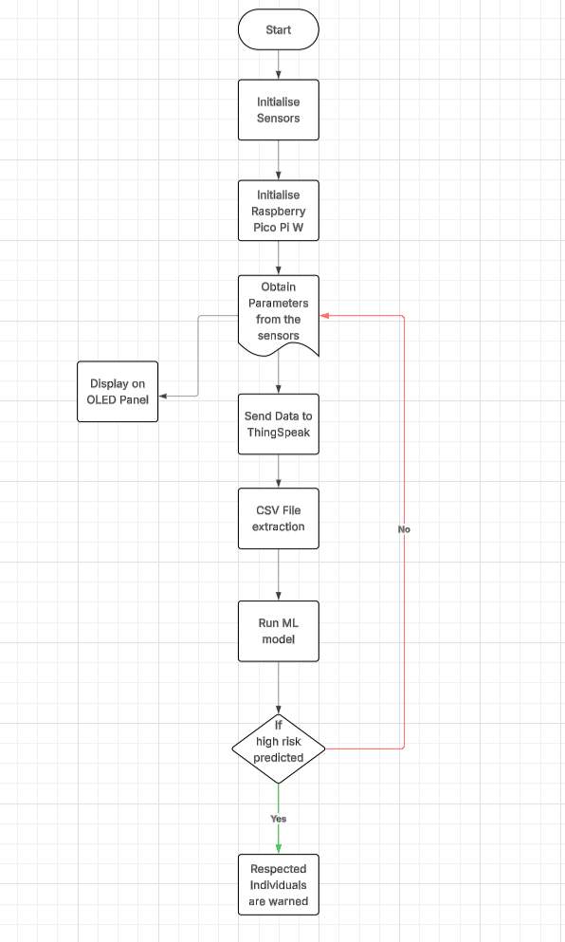
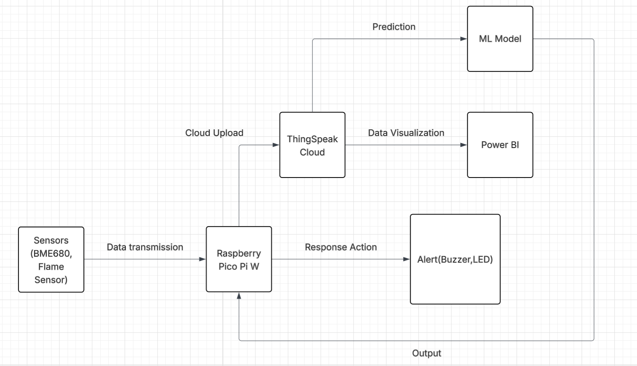
System Design
Embedded Interactions
Flow Chart
Flowchart

Slide 11
Implementation Details
Step 1: Ideation & Planning
Step 2: Simulation on Wokwi
Step 3: Transition to Hardware
Step 4: Data Generation & ML Modeling

Slide 12
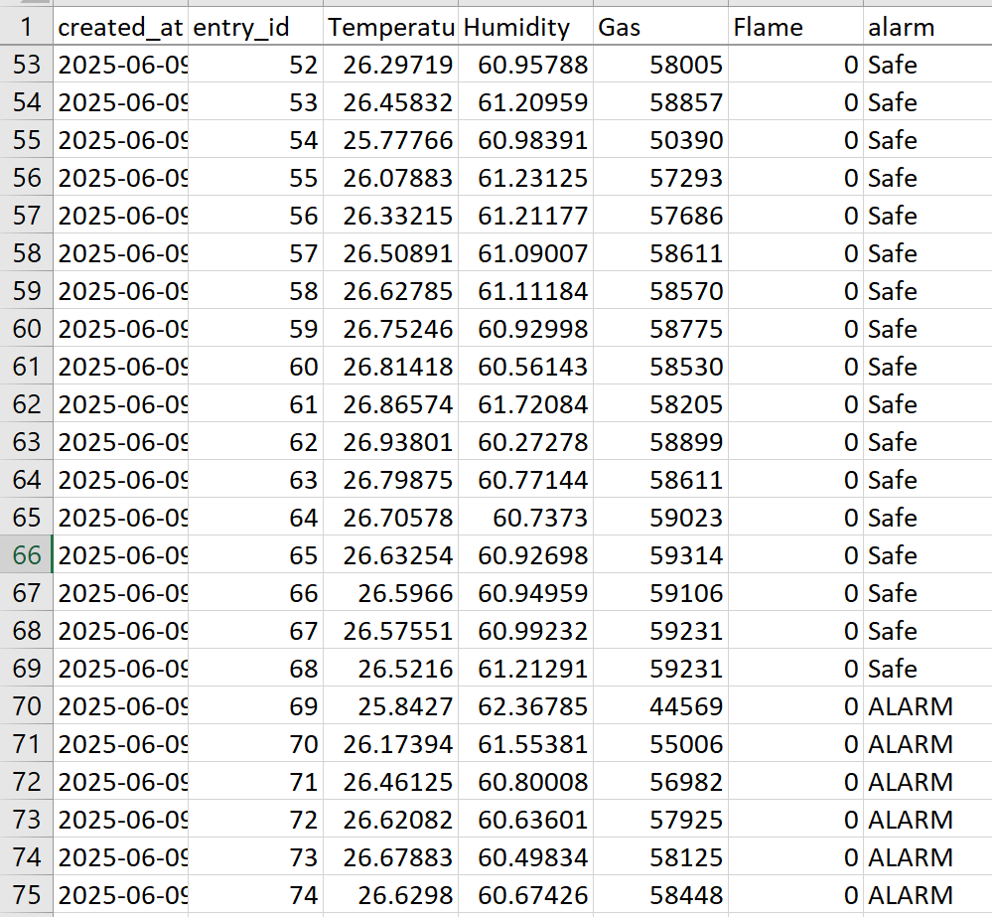
Dataset
ThingSpeak Exported CSV FIle

Slide 13
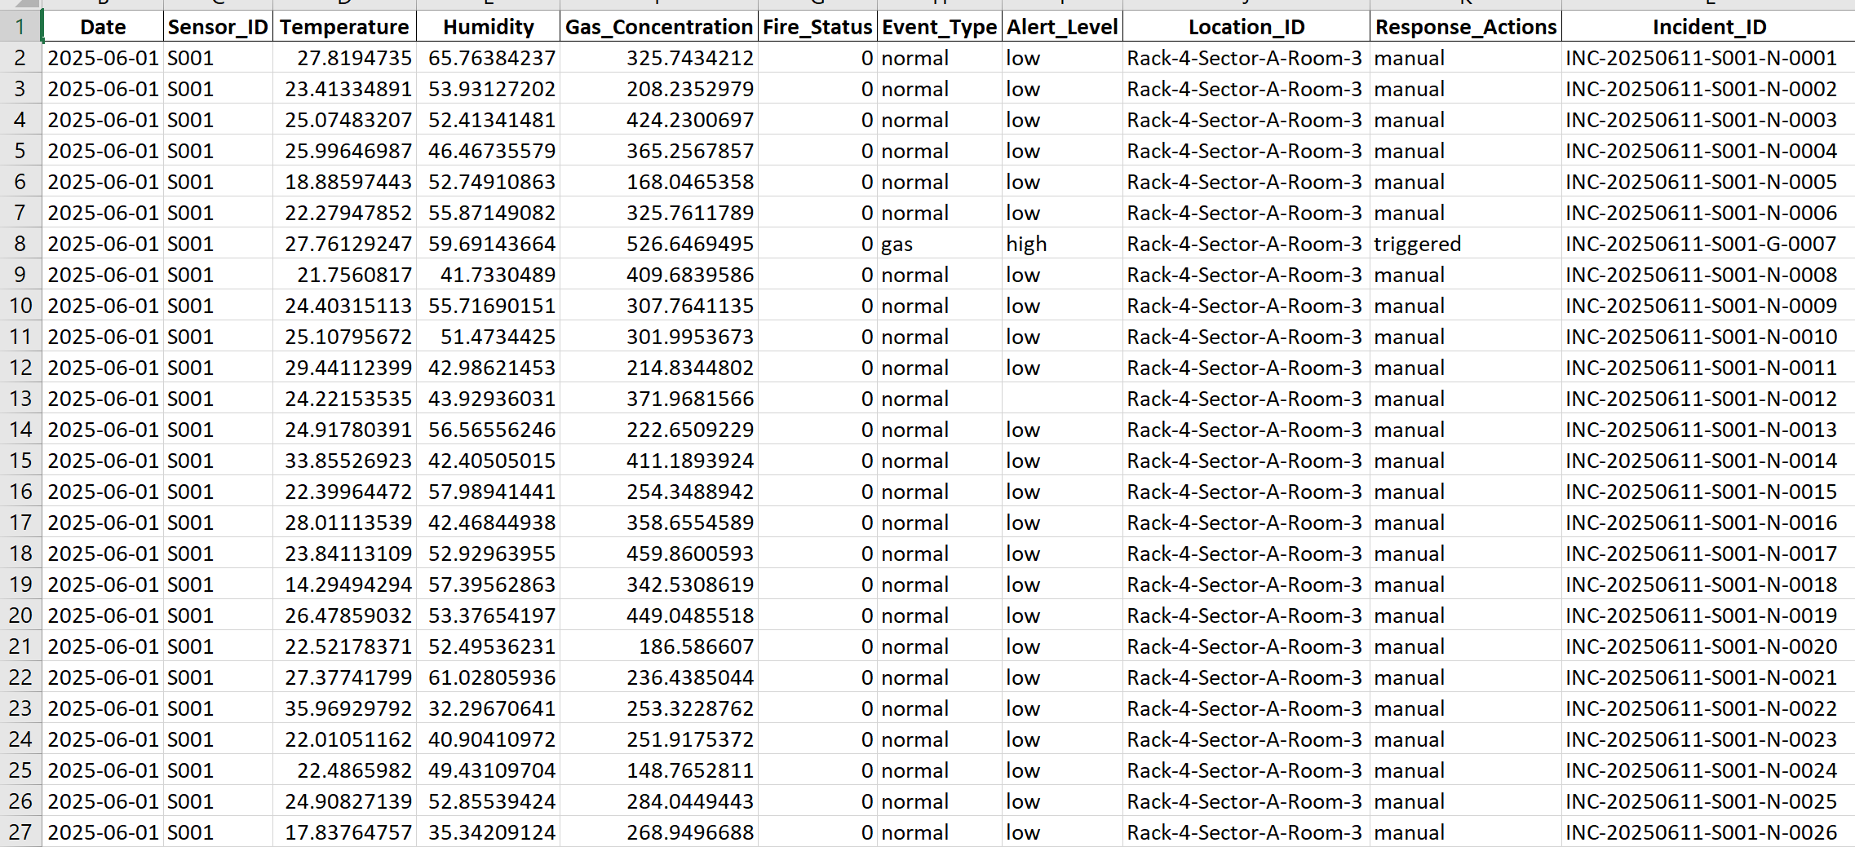
Dataset
Final Dataset

Slide 14
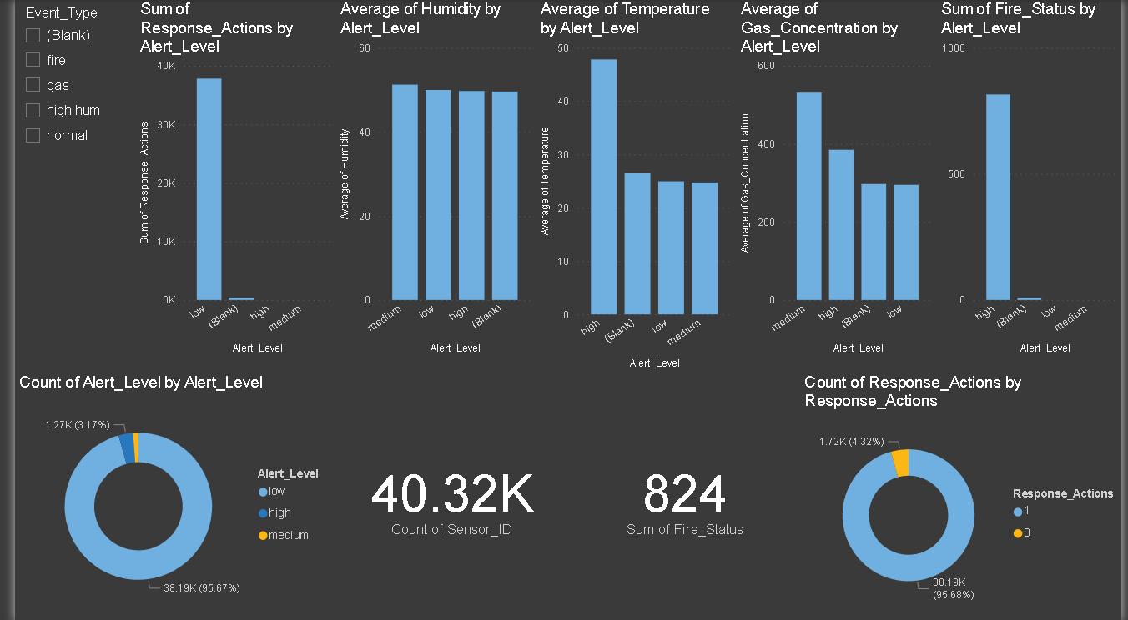
Results & Observations : PowerBI
Dashboard

Slide 15
ML Model : XGBoost Classifier
EDA: Explored the dataset to understand feature distributions, detect missing values, and uncover hidden patterns.
Preprocessing: Cleaned and transformed the data using encoding, scaling, and handling missing values to prepare it for modeling.
Training: Trained the XGBoost Classifier model using labeled data to learn patterns and make accurate predictions.
Evaluation Matrix: Assessed model performance using confusion matrix, precision, recall, and F1-score for each target class.

Slide 16
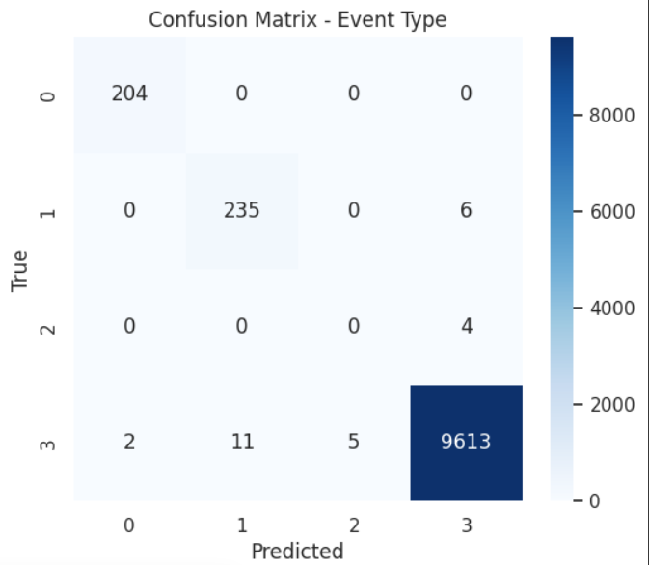
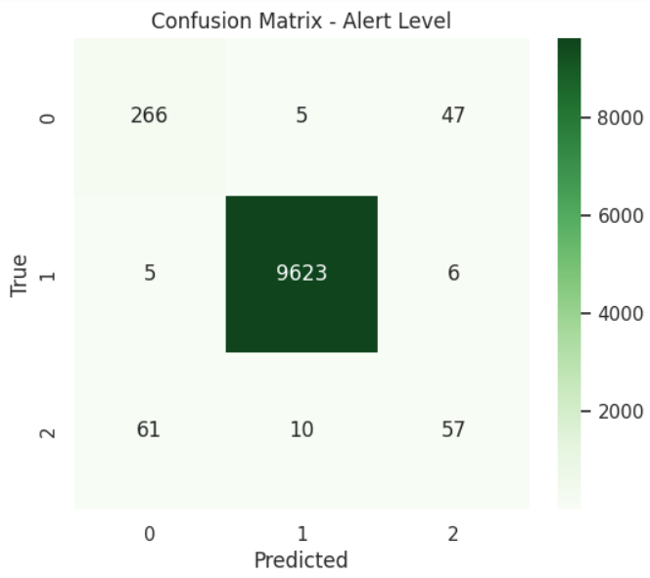
Results & Observations
Accuracy of the model
Performance of the embedded system

Slide 17
Advantages & Limitations
Key Benefits
Real-time hazard detection with automatic alerts through ThingSpeak and buzzer
Scalable system design supporting ML model integration for predictive safety
Low-power embedded solution using Raspberry Pi Pico W and BME680
Cloud connectivity enables remote monitoring and centralized data logging
Cost-effective setup using open-source tools and affordable hardware
Limitations
Internet dependency for real-time cloud communication and ML inference
Limited on-device processing power restricts local ML model deployment
Synthetic dataset used for training – model may need retraining on real-world data
Latency in cloud-based predictions depending on network conditions
Security concerns if MQTT/HTTP communication isn't encrypted

Slide 18
Future Scope
Scalability & Improvements:
Integrate additional sensors (CO₂, motion, flame) for enhanced safety
Implement edge ML on Raspberry Pi Pico for real-time anomaly prediction
Enable wireless communication (LoRa, GSM) for remote sites
Add mobile alerts (SMS/email) via IFTTT or Twilio
Support multi-node deployments for larger warehouses
Integrate ML predictions into live system (via cloud or edge inference)
Automatically reflect predictions on OLED and trigger alerts
Real-World Deployment Possibilities:
Industrial warehouses with flammable or perishable goods
Cold storage and food preservation units
Smart building infrastructure and data centers
Healthcare environments requiring controlled atmospheres
Government and defense storage for hazard detection

Slide 19
Conclusion
Summary of Learnings
Gained hands-on experience in integrating embedded systems with IoT platforms
Understood the process of data collection, transmission, and visualization using ThingSpeak
Learned how to simulate sensor environments using Wokwi before hardware deployment
Explored basic machine learning workflows including dataset creation, EDA, and LSTM model training
Realized the potential of predictive analytics in enhancing safety systems
Key achievements
Successfully built a live hazardous monitoring system using Raspberry Pi Pico and BME680 sensor
Developed a multi-version simulation for validation before hardware implementation
Enabled real-time cloud data logging and visual alerts via OLED and buzzer
Created a 7-day synthetic dataset to train an ML model for early anomaly detection

Slide 20
Thank you

